Slide 1
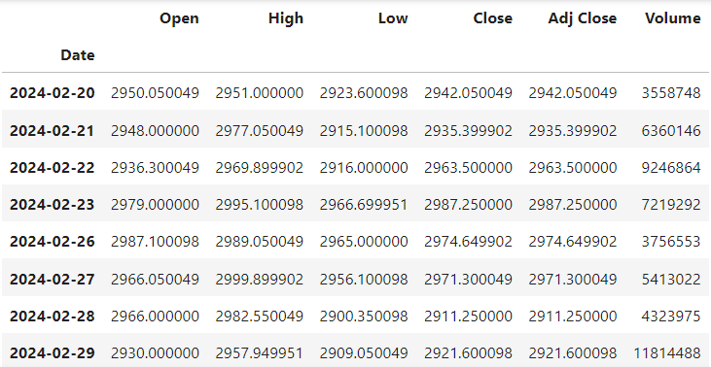
STOCK MARKET PREDICTION
Company Name – Reliance Industries
Algorithm Used : Linear Regression, Support Vector Machine, KNN, DT, Random Forest, LSTM
Features Used : Open, High, Low, Close
Input Data – 7 Days (1 week) (Only working days included)

Slide 2
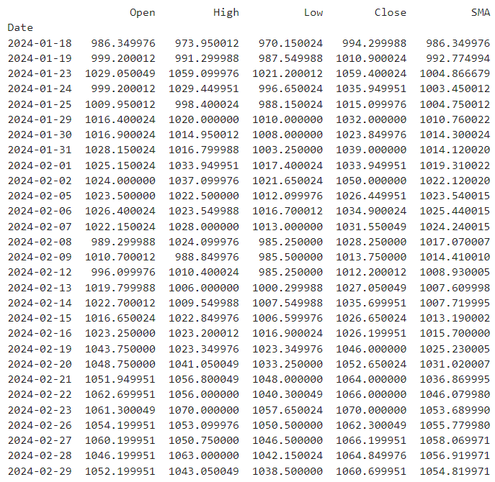
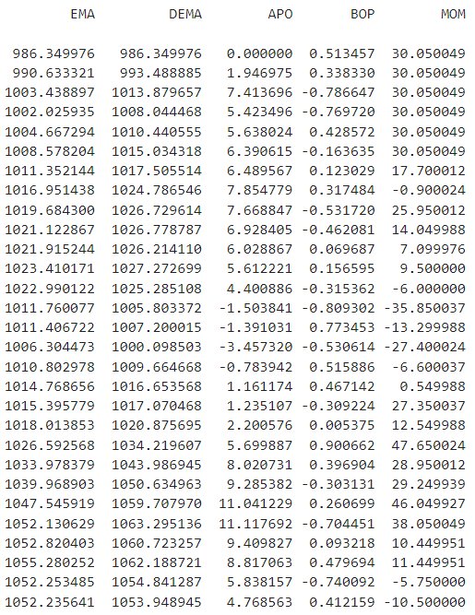
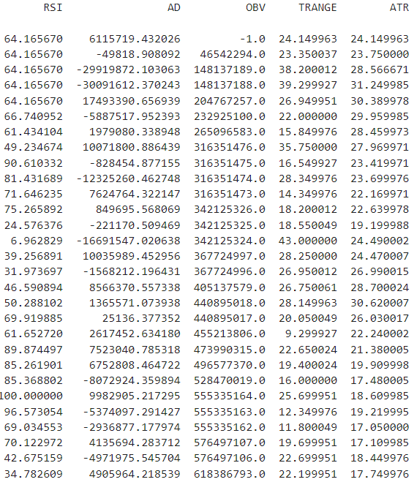

Slide 3
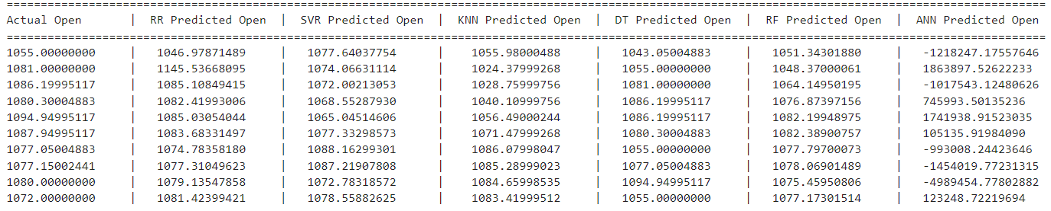
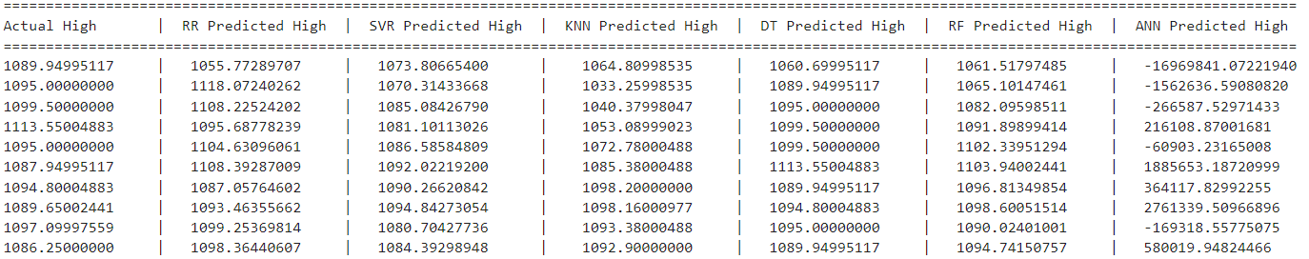
COMPARED ACTUAL AND PREDICTED PRICES
OPEN
HIGH

Slide 4
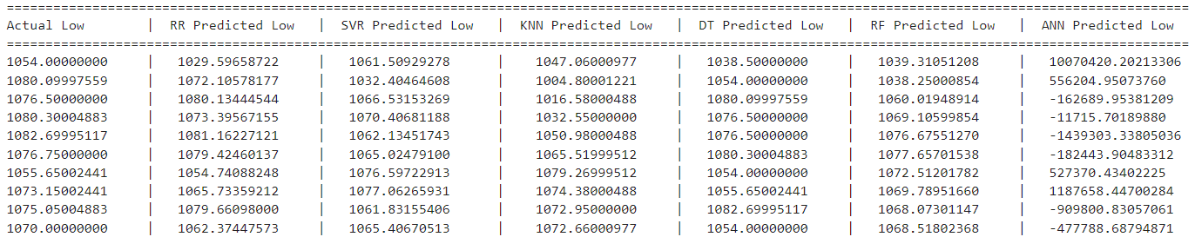
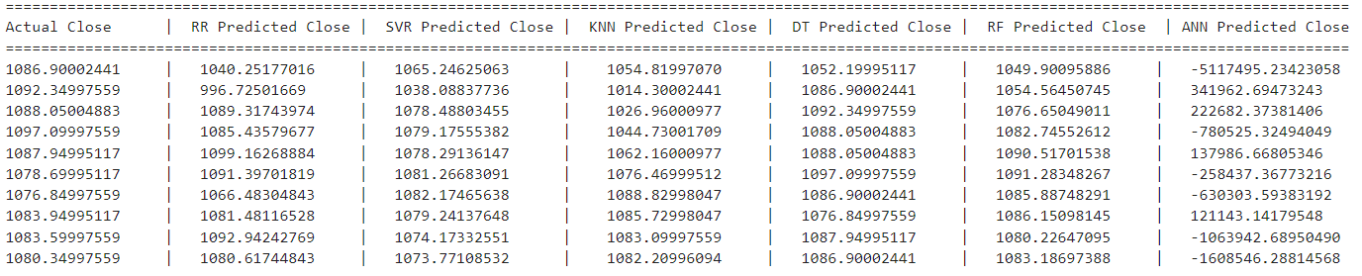
COMPARED ACTUAL AND PREDICTED PRICES
LOW
CLOSE

Slide 5
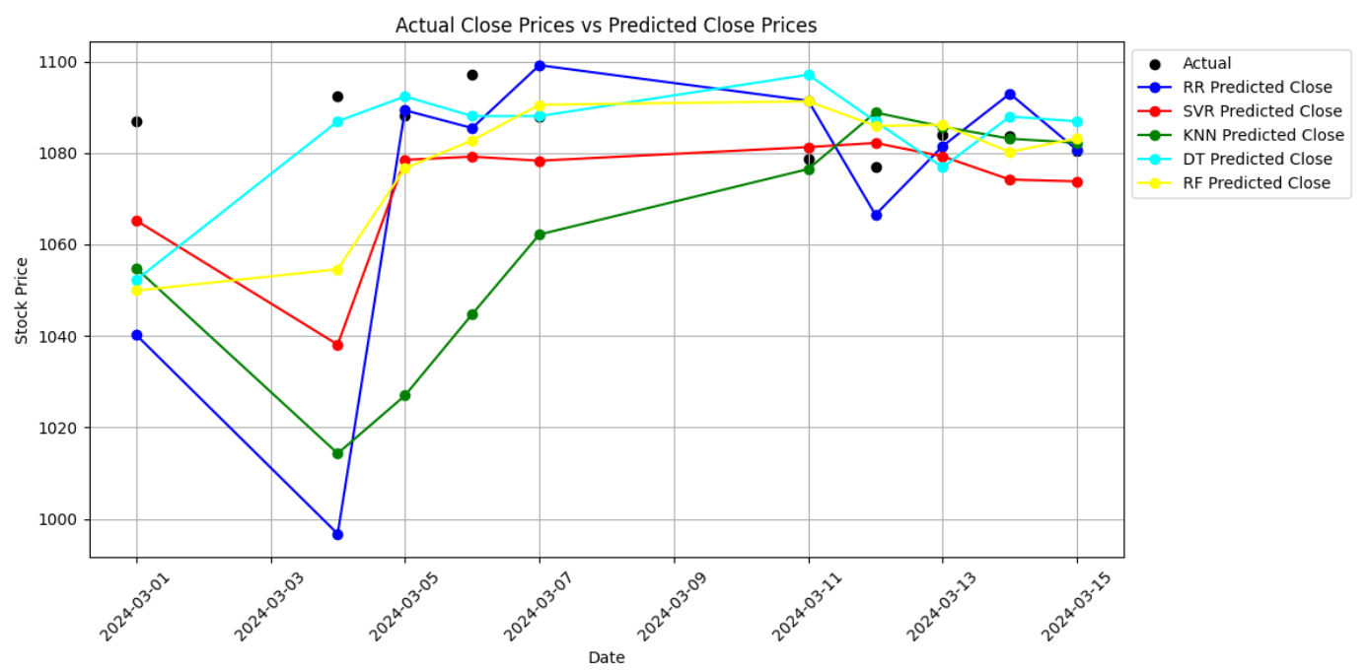
OPEN PRICE

Slide 6
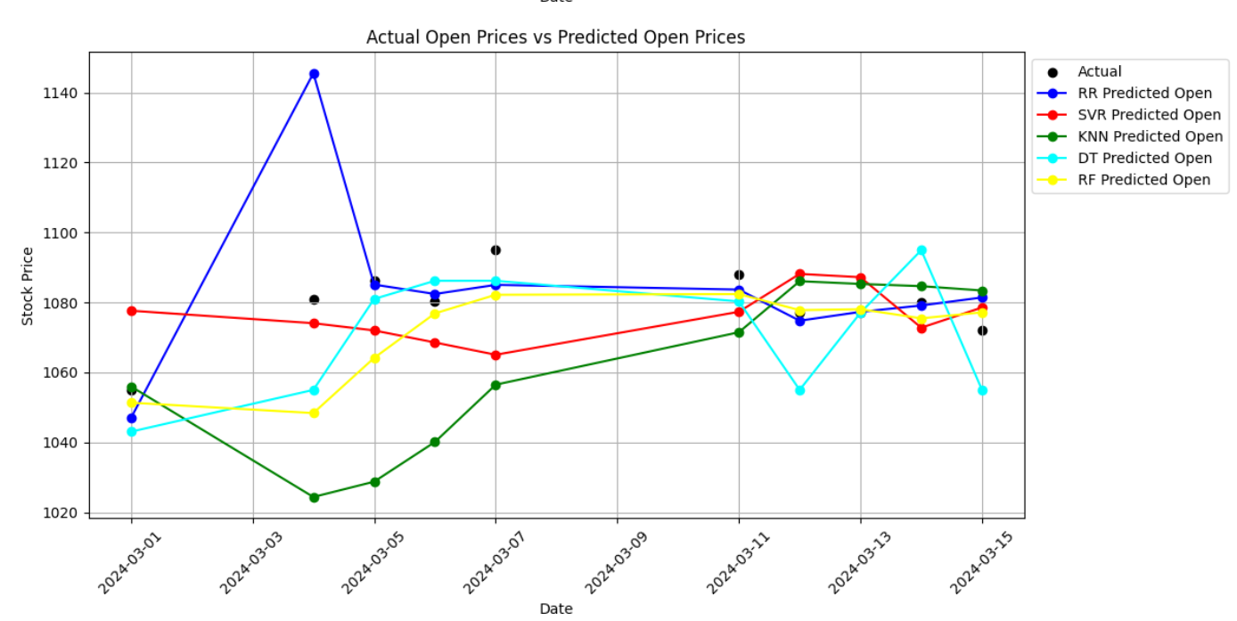
HIGH PRICES

Slide 7
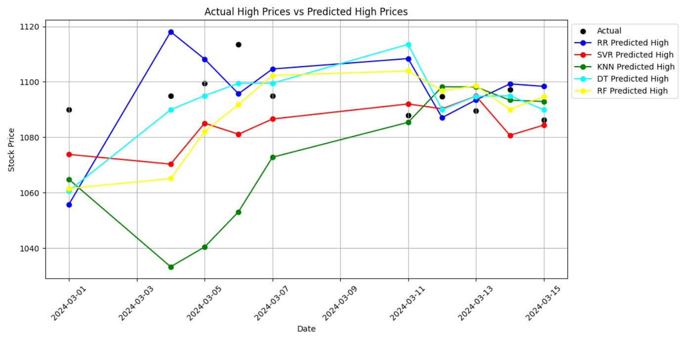
LOW PRICES

Slide 8
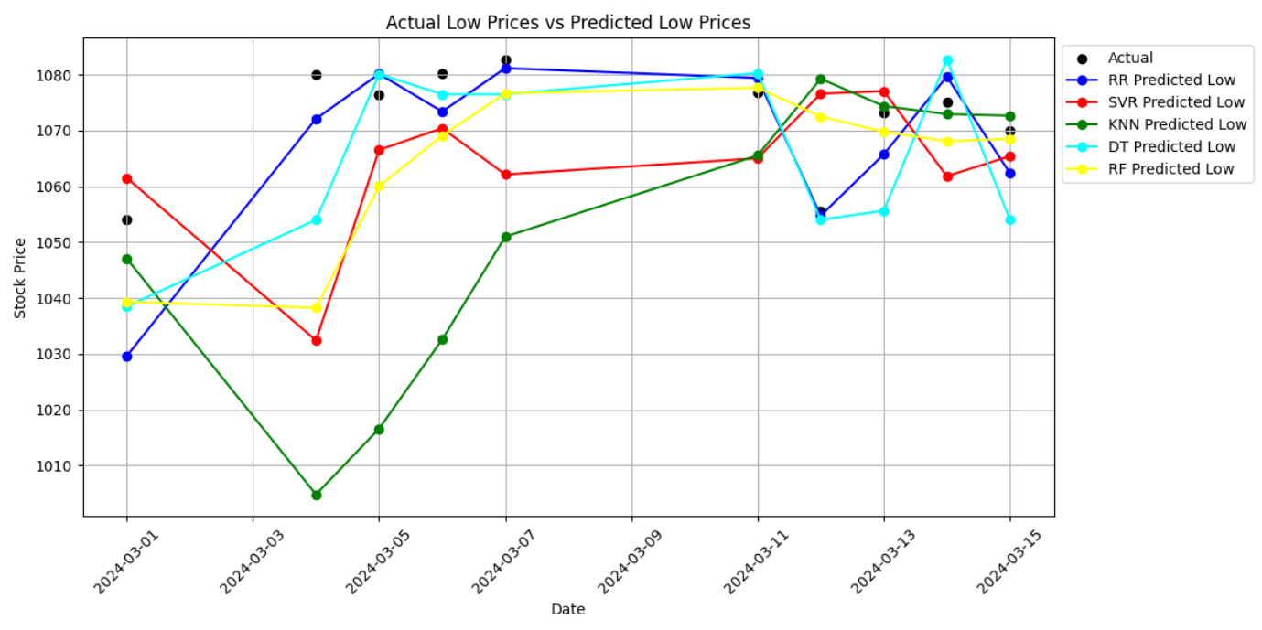
CLOSE PRICES

